Slide 1
Final Project
Online Data Analytics

Slide 2

Intensive 24-week online program is fast-paced and focuses on the technical skills needed to solve real-world data problems.
Gain proficiency in numerous in-demand technologies, including Excel, Python, JavaScript, SQL Databases, Tableau, Machine Learning, and more
Final Project due in Mid-August 2022

Slide 3
N-Butane Recycle Build Up
•Utilize principal component analysis, and neural networks to develop machine learning methods to predict probably of N-Butane build up.
•Input RX, Tower A, Tower B, and Tower C data, twice daily N-Butane samples for qualifier
•Outputs are probability percentage that we are building or purging N-Butane.
•No side-draw for N-Butane at Tower A, RVP penalty for dropping i-Butane is severe.
•Current procedure is relying on twice daily samples.
•Operations are blind in-between samples, as is efforts to measure N-Butane balance
•Operations have noticed correlations with Tower A overhead temperature ( >135F) as early warning of N-C4 build up.
•ML Model goal is to input all tower and reactor data and predict the statistical probability that we are in a “N-Butane Build-Up” mode

Slide 4
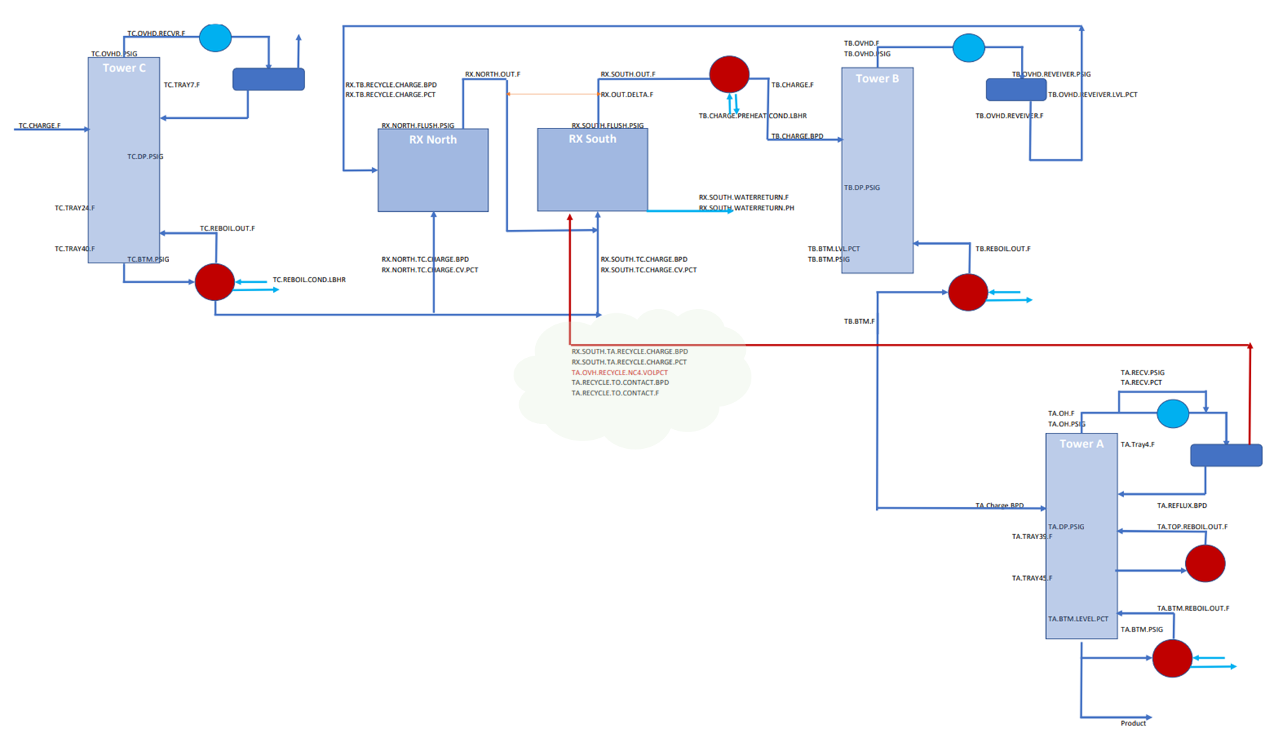
Process Block Flow

Slide 5
What customers do today
Justify your effort to try to solve the problem.
Highlight the pain points of the current solution or how customers deal with not having a solution to the problem.

Slide 6
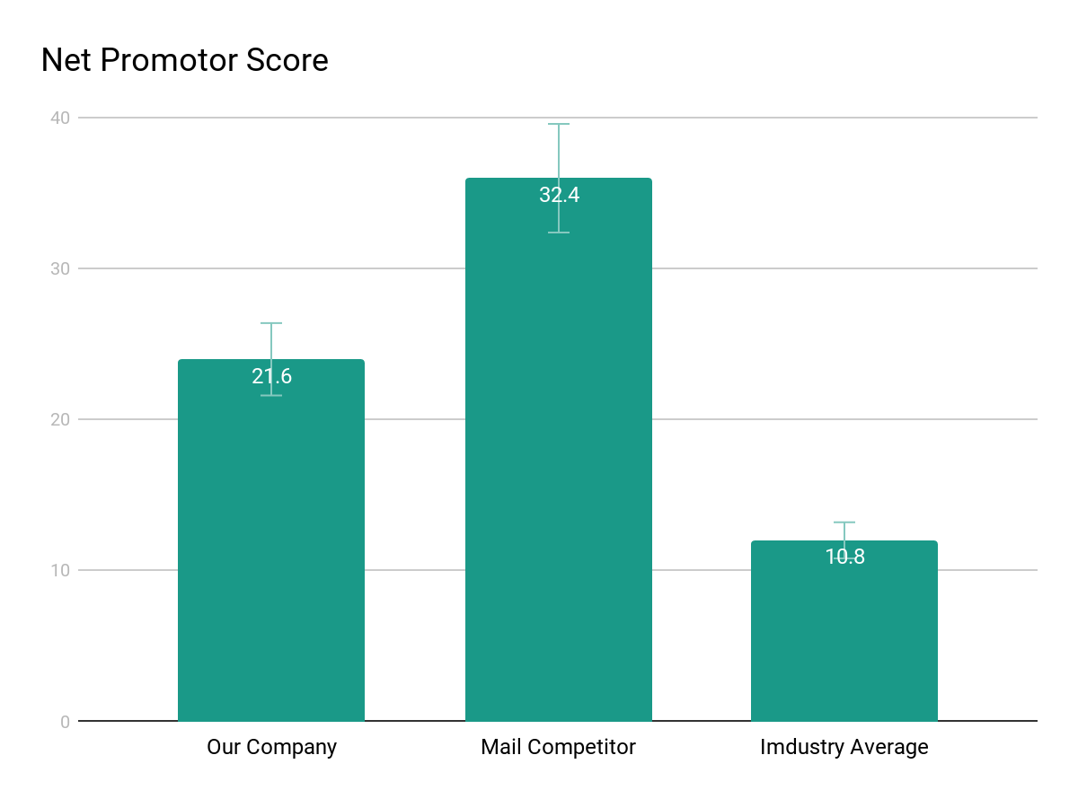
Supporting information
01
1
List any research or data you have to support the need for a solution.

Slide 7
Supporting information
02
82%
Users are constantly searching for a solution
Explain why you’re focusing on a particular part of the problem or a particular subset of users.

Slide 8

Supporting information
03
Julia
Team Manager
Reference your personas, if you have them.
Describe the content of Julia’s job and the problem she and her team are currently facing.

Slide 9
Use cases / user stories
Use cases, user stories, notes to set up the wireframes. Such as…
“As an Administrator, I would like to restrict permissions based on role.”
“As a Moderator, I would like to flag and approve comments.”
Executives indicated that being able to see a summary of each segment of data was their #1 priority.
Note: secondary admin workflow not planned for this release.

Slide 10
Assumptions
State your assumptions or any unknowns here.

Slide 11
Solution Proposal

Slide 12
Solution description
Now that you’ve justified your attention to the problem, summarize your solution in one or two sentences.

Slide 13
Why it’s better than existing solutions
Return to the problem now that you’ve introduced your solution. Compare your solution to others and describe how it is superior.

Slide 14
Wireframes

Slide 15
Next Steps

Slide 16
What next?
Present the timeline.
Solicit comments on these slides or reviews on these wireframes in the Balsamiq add-on.
User testing plan.

Slide 17
Timeline
MAY
JUN
TODAY
AUG
SEPT
OCT
NOV
Requirements gathering
User research
Wireframes
Review
Prototype
User testing
Dev hand-off

Slide 18
Questions?

Slide 19
References
Tips for Presenting Your Wireframes
3 Steps to Better UI Wireframes
Wireframing for Beginners

